Slide 1
Agentic RAG Chatbot for Multi-Format Document QA using Model Context Protocol (MCP)
By:
Srikar Chintala

Slide 2
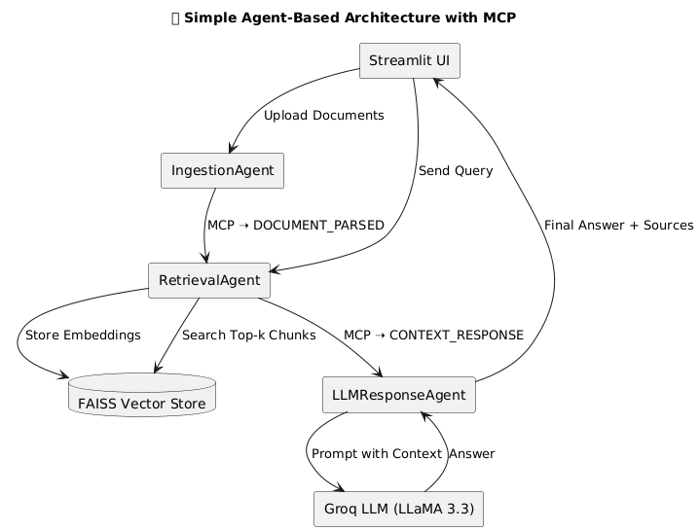
Agent-based architecture with MCP integration

Slide 3
System flow diagram
Question Answering Workflow
Streamlit UI
Coordinator Agent
Retrieval Agent
FAISS
LLM Response Agent
GroqLLM
Document Upload Workflow
Streamlit UI
Coordinator Agent
Ingestion Agent
RetrievalAgent
FAISS
Forward user query
Forward uploaded files
MCP: CONTEXT_RESPONSE
Trigger retrieval process
Trigger document parsing
Parse & split into chunks
Semantic search (top-k chunks)
MCP: DOCUMENT_PARSED
Payload: { “chunks”, “doc_name”}
Generate embeddings and save chunks metadata
Return answer
Store in FAISS index
Send formatted prompt

Slide 4
Tech Stack Used
LLM : llama-3.3-70b-versatile (from Groq Cloud)
Embeddings : all-MiniLM-L6-v2
Vector Store : FAISS
UI Framework : Streamlit
Protocol Layer : Custom MCP (in-memory messaging)
Language : Python

Slide 5
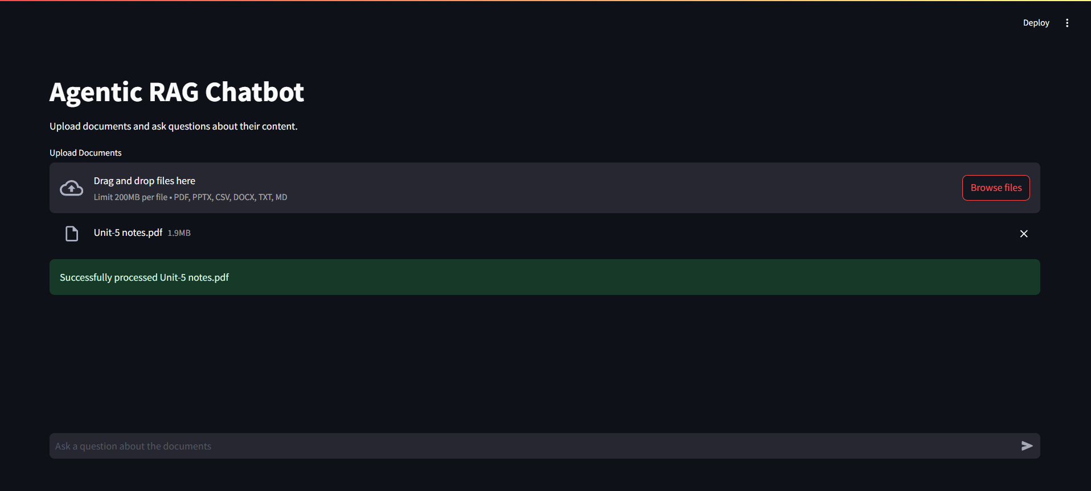
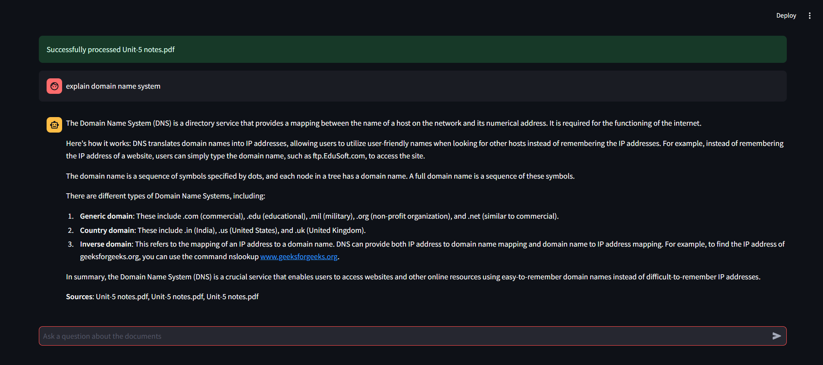
UI Screenshots

Slide 6
Document Uploaded

Slide 7
Challenges Faced
Complex Document Parsing : Varied formats (PDF, PPTX, CSV, DOCX, TXT, Markdown) caused parsing errors in ingestion_agent.py
Solution : Used robust libraries, error handling.
Semantic Meaning in Chunking: Splitting text in ingestion_agent.py risked losing
Solution : Used RecursiveCharacterTextSplitter with tuned chunk size (1000) and overlap (200).
Groq API Rate Limits: Frequent LLM calls in llm_response_agent.py risked failures.
Solution : added error handling, planned caching.
Future Scope
Multi-Language Support: Add language detection and translation in ingestion_agent.py for non-English documents.
Advanced Document Support: Add OCR for image-based PDFs and support HTML/JSON in ingestion_agent.py.
Async Processing: Use asynchronous parsing in ingestion_agent.py to speed up large document uploads.

